Slide 1
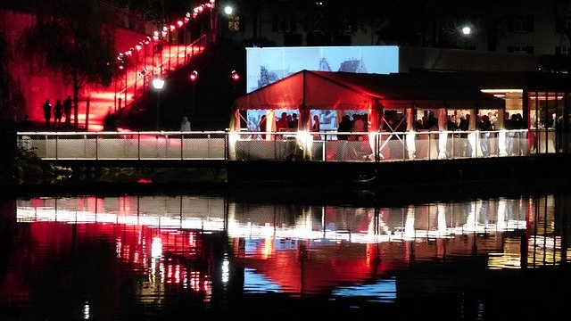
Women Tech Women Yes Summer Gala Engagement
Street Team Placement
Chuck Cao
Chris Chan
Humza Khan
Joshua Mailman

Slide 2
Agenda
Objective
What We Did
Results
Recommendations
Future Work

Slide 3
Objective
Optimize street team placement to gather names and email addresses of those who will attend gala and contribute to cause.

Slide 4
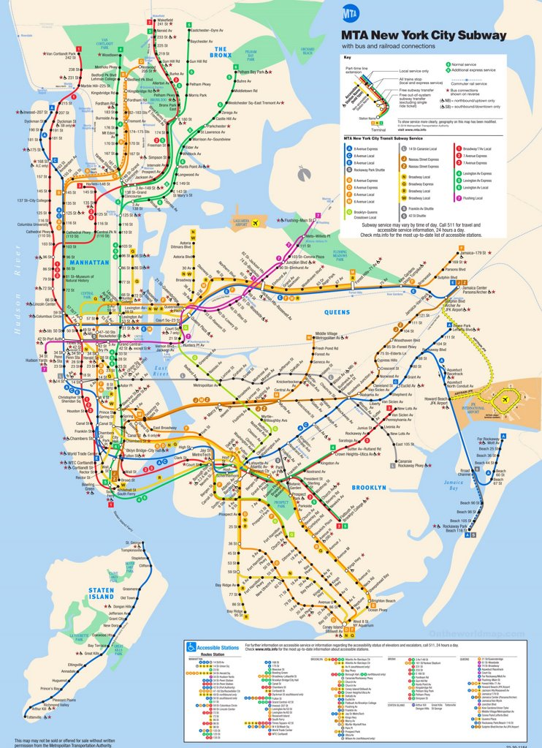
What We Did
Four weeks of July 2019 MTA turnstile data
472 Stations
20.7M NYC metro area residents
Pandas, matplotlib, seaborn

Slide 5
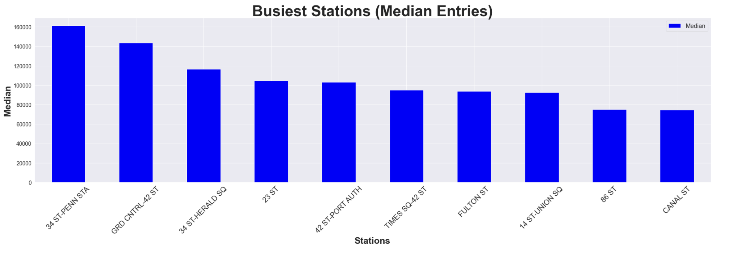


Slide 6
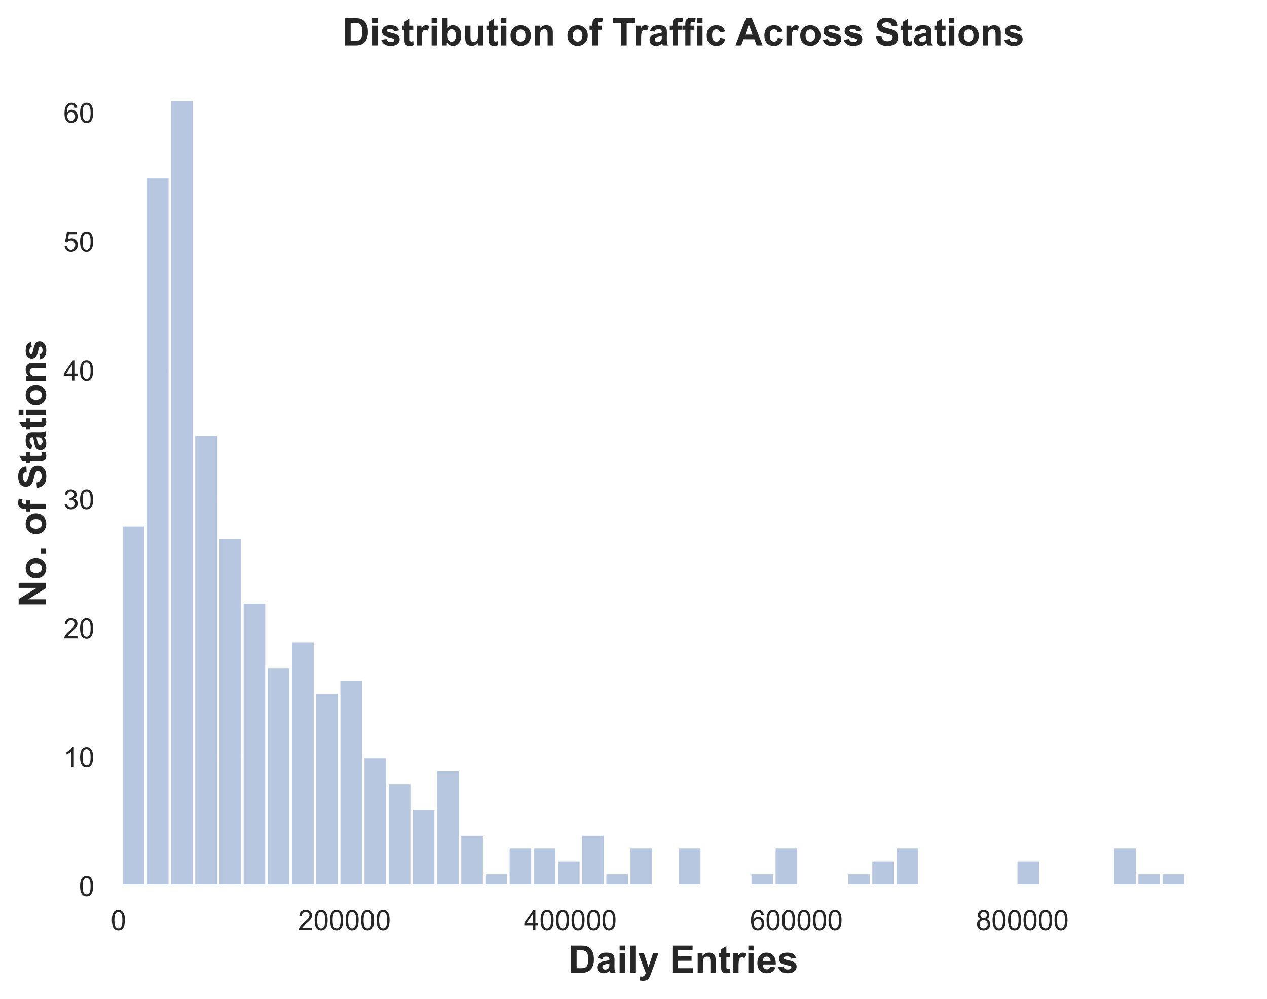

Slide 7
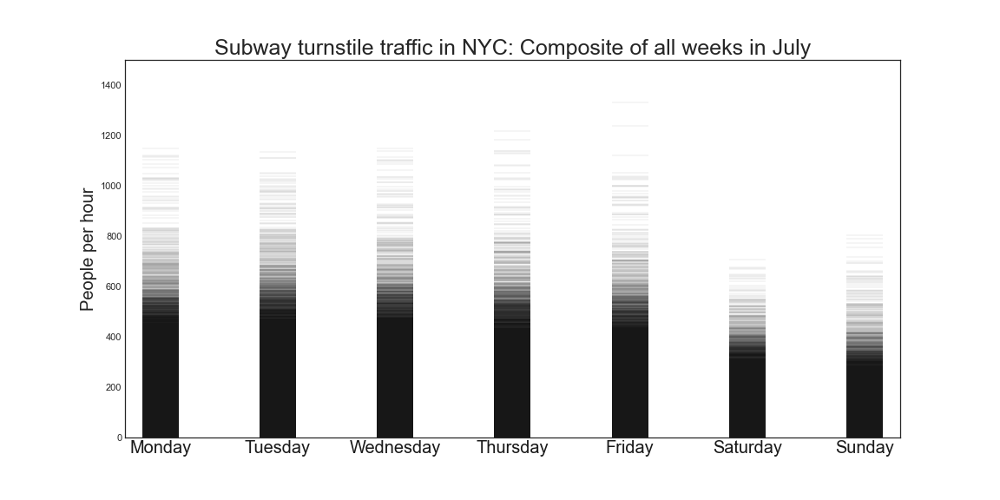
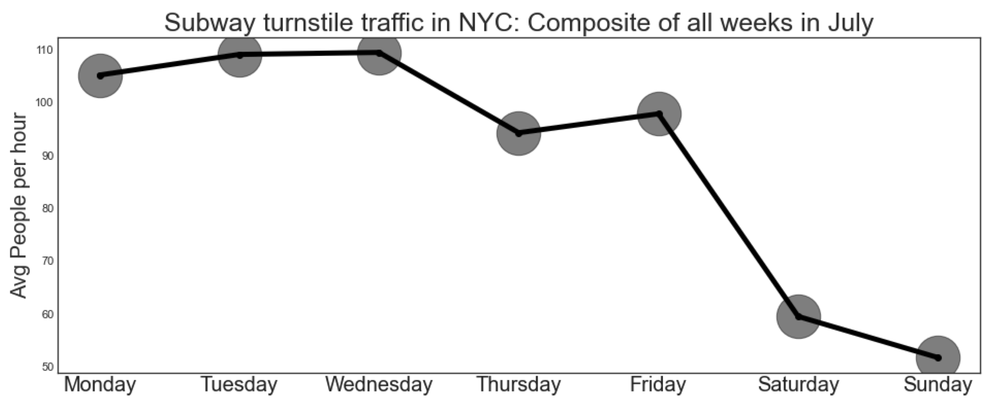
Turnstile Fluctuation By Day

Slide 8
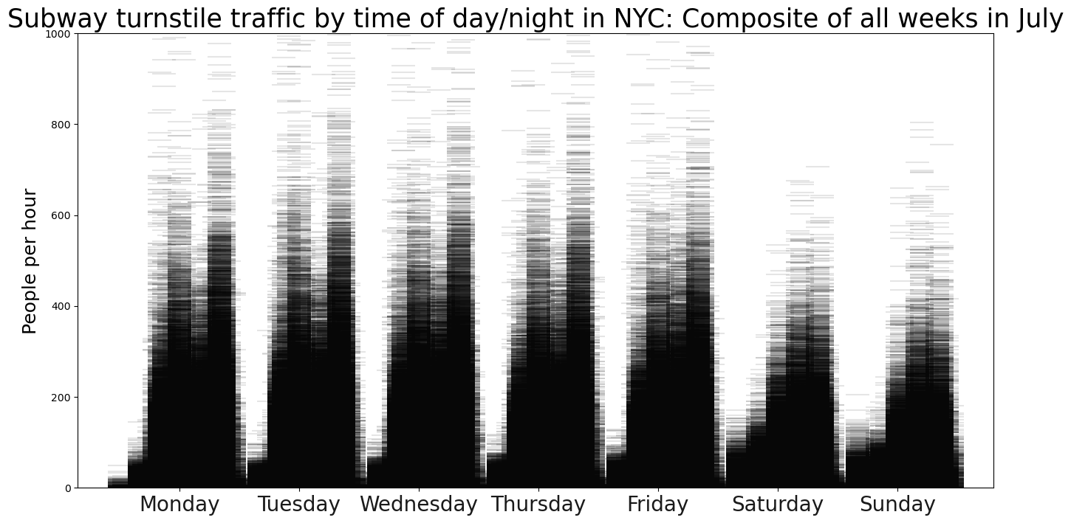
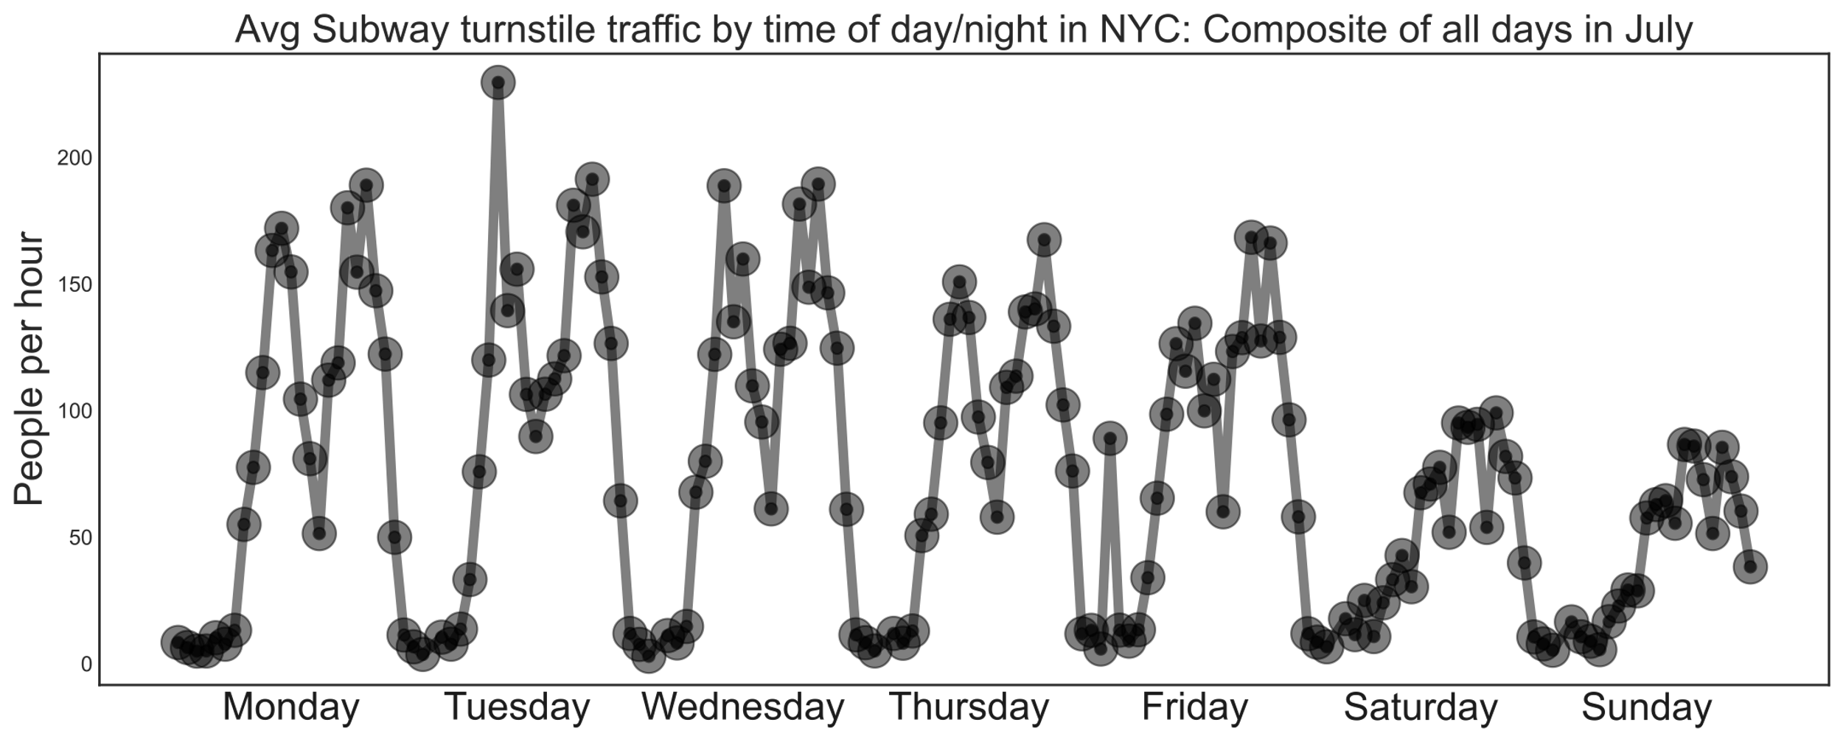
Turnstile Fluctuation By Time During The Week

Slide 9
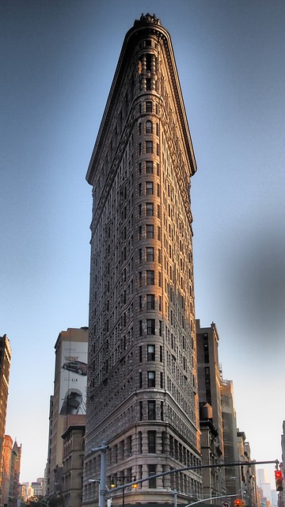
Location, Location, Location

Slide 10
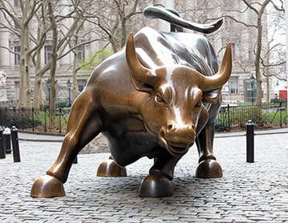
Show me the Money!
Top 10 Subway Stations by Household Income
Top 10 Subway Stations by Household Income

Slide 11
Median Household Income by Subway Station: 10,000 Foot Overview
Where are the highest reported median HH incomes in NYC?
What stations have the most turnstile traffic?
Can we narrow our target area further?

Slide 12
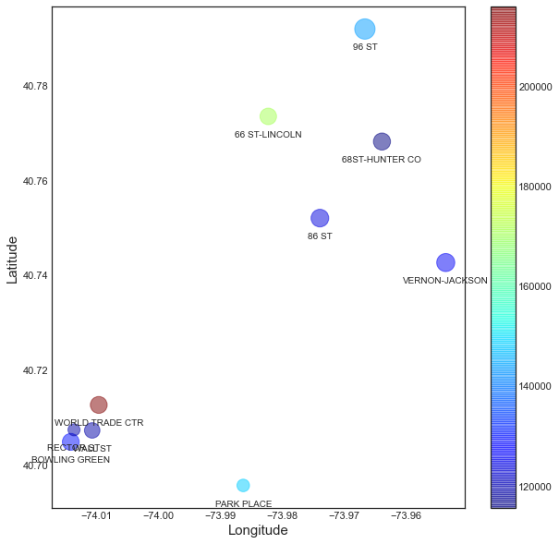
Top 10 Subway Stations by Household Income: 5,000 Foot Overview

Slide 13
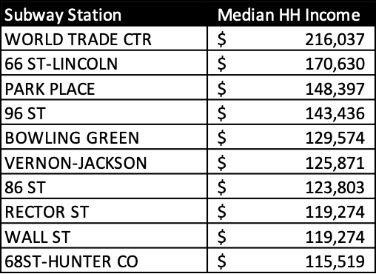
World Trade Center Station Highest Median Household Income

Slide 14
Location, Location, Location
The Flatiron district: NYC’s tech hub

Slide 15
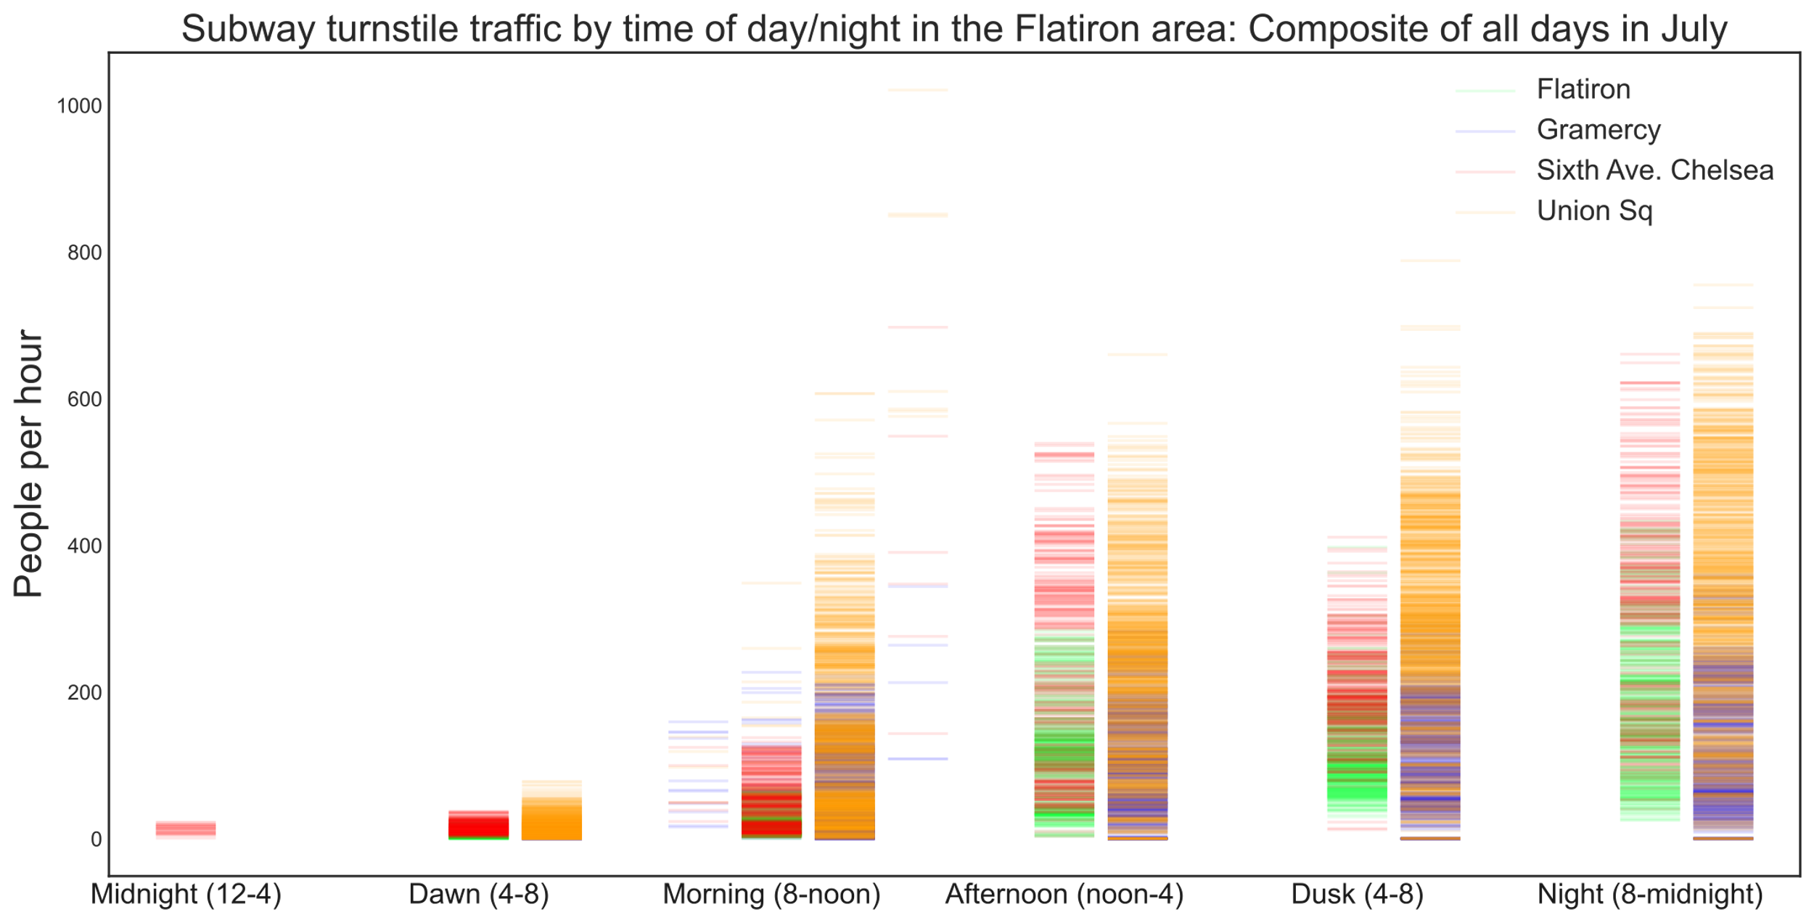
The Flatiron district: NYC’s tech hub

Slide 16
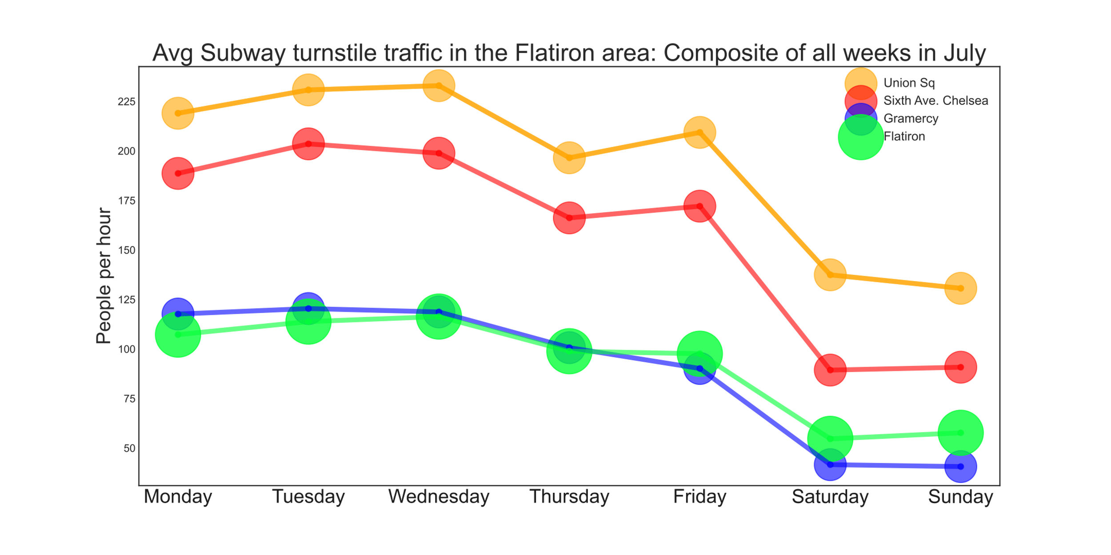
The Flatiron district: NYC’s tech hub

Slide 17
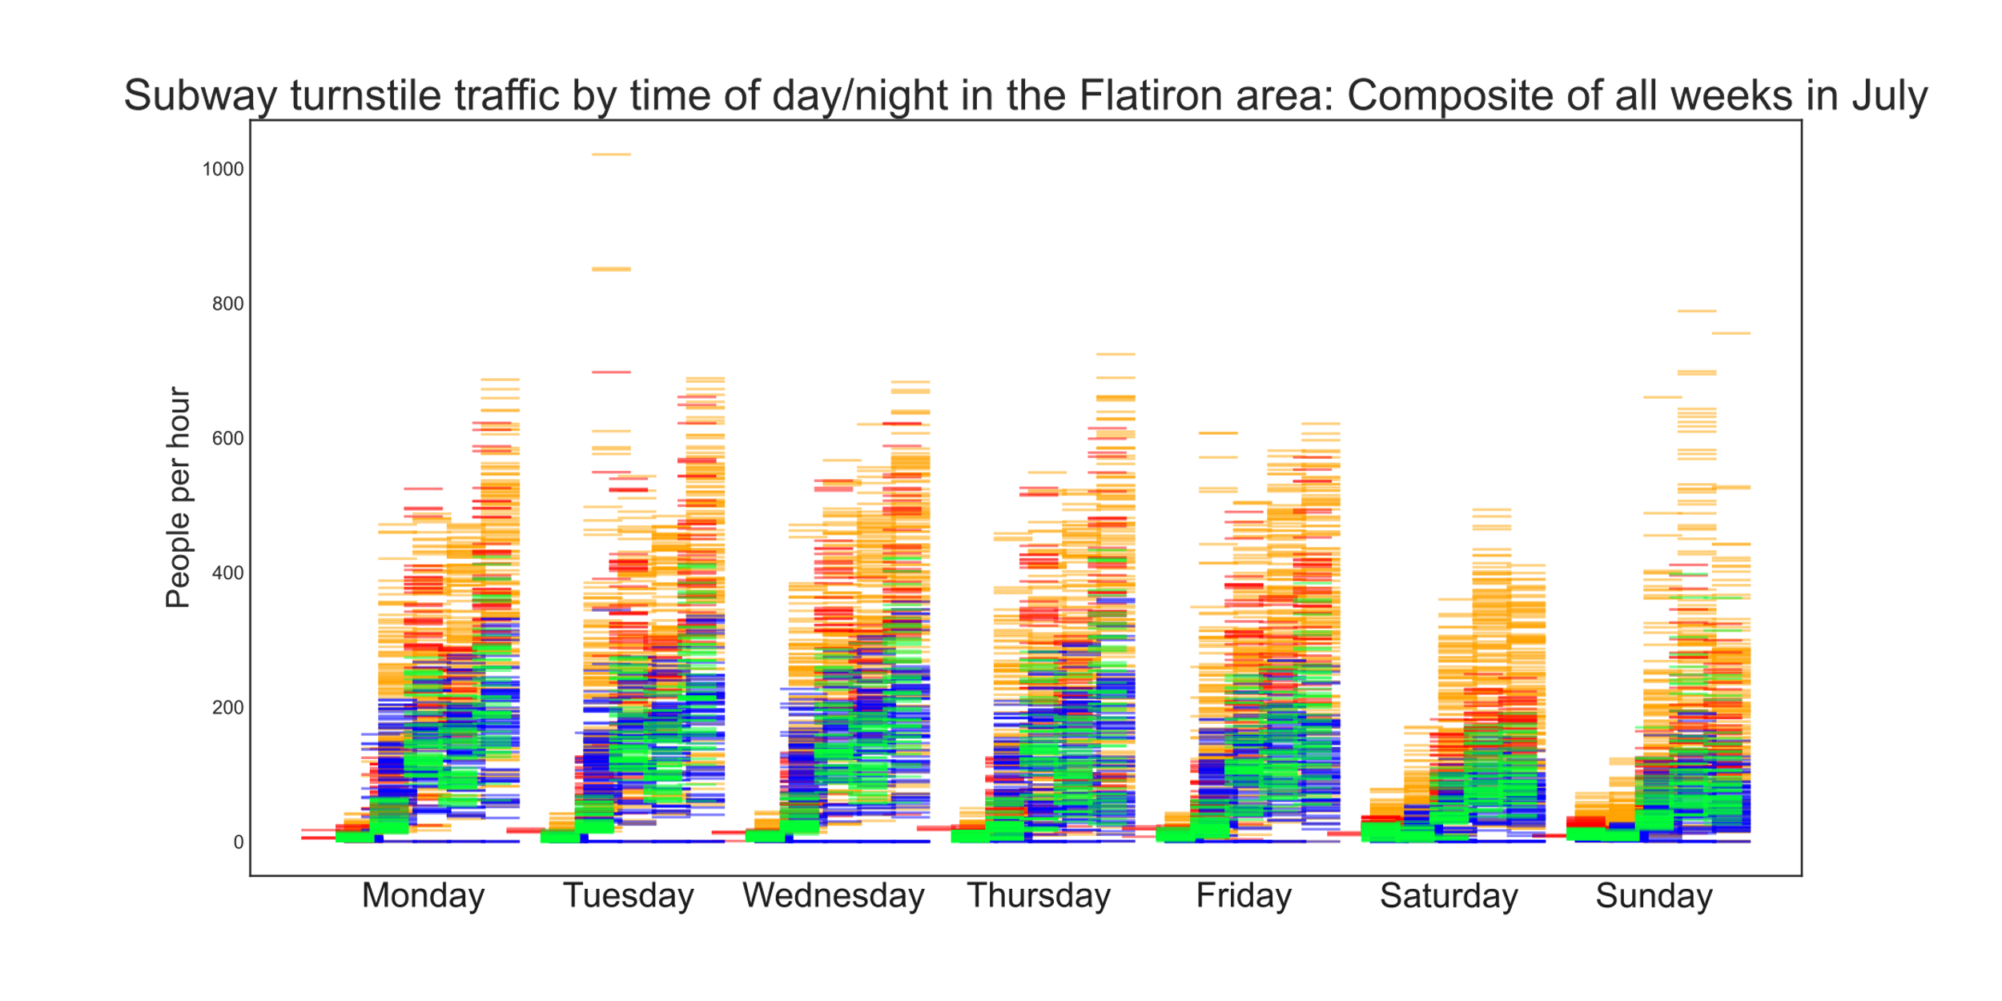
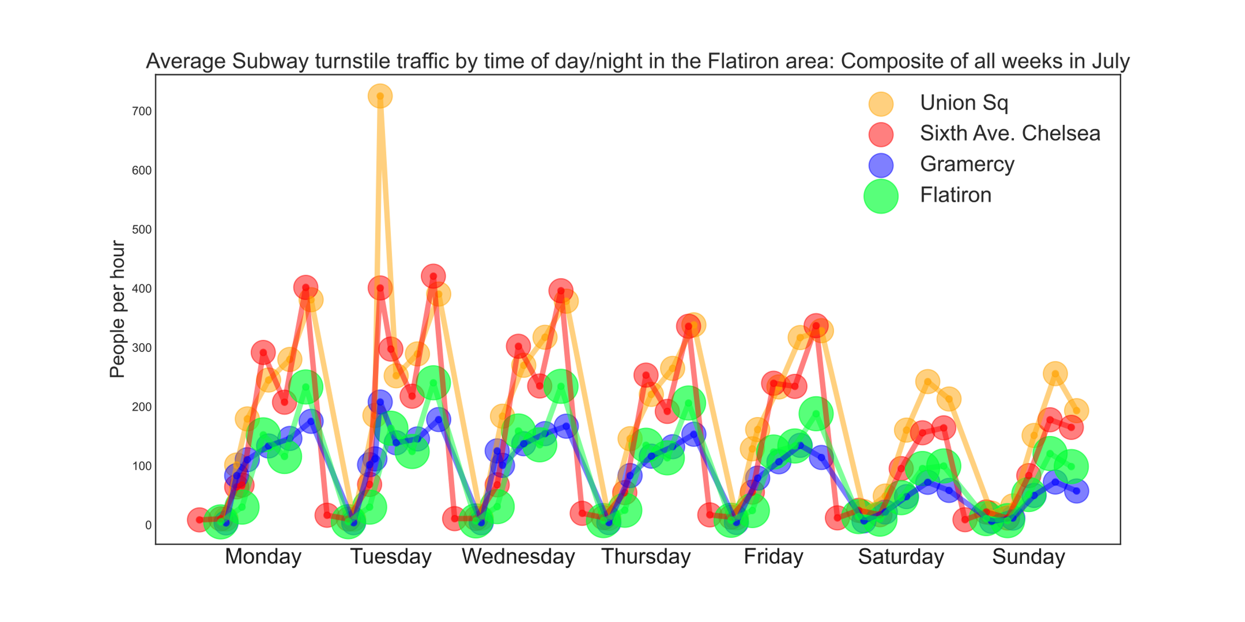
The Flatiron district: NYC’s tech hub

Slide 18
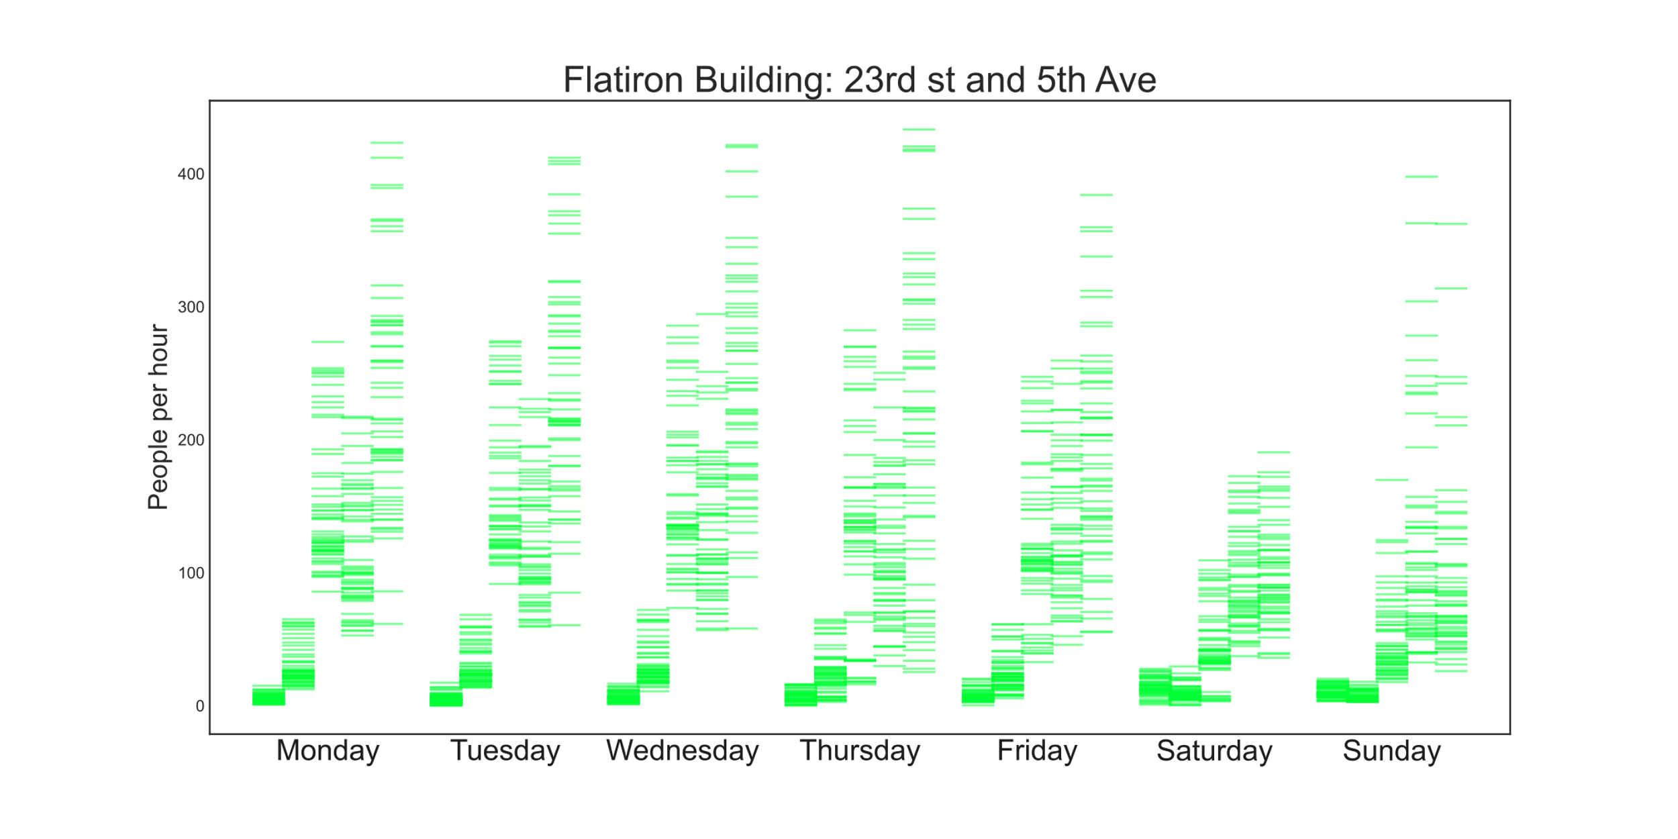
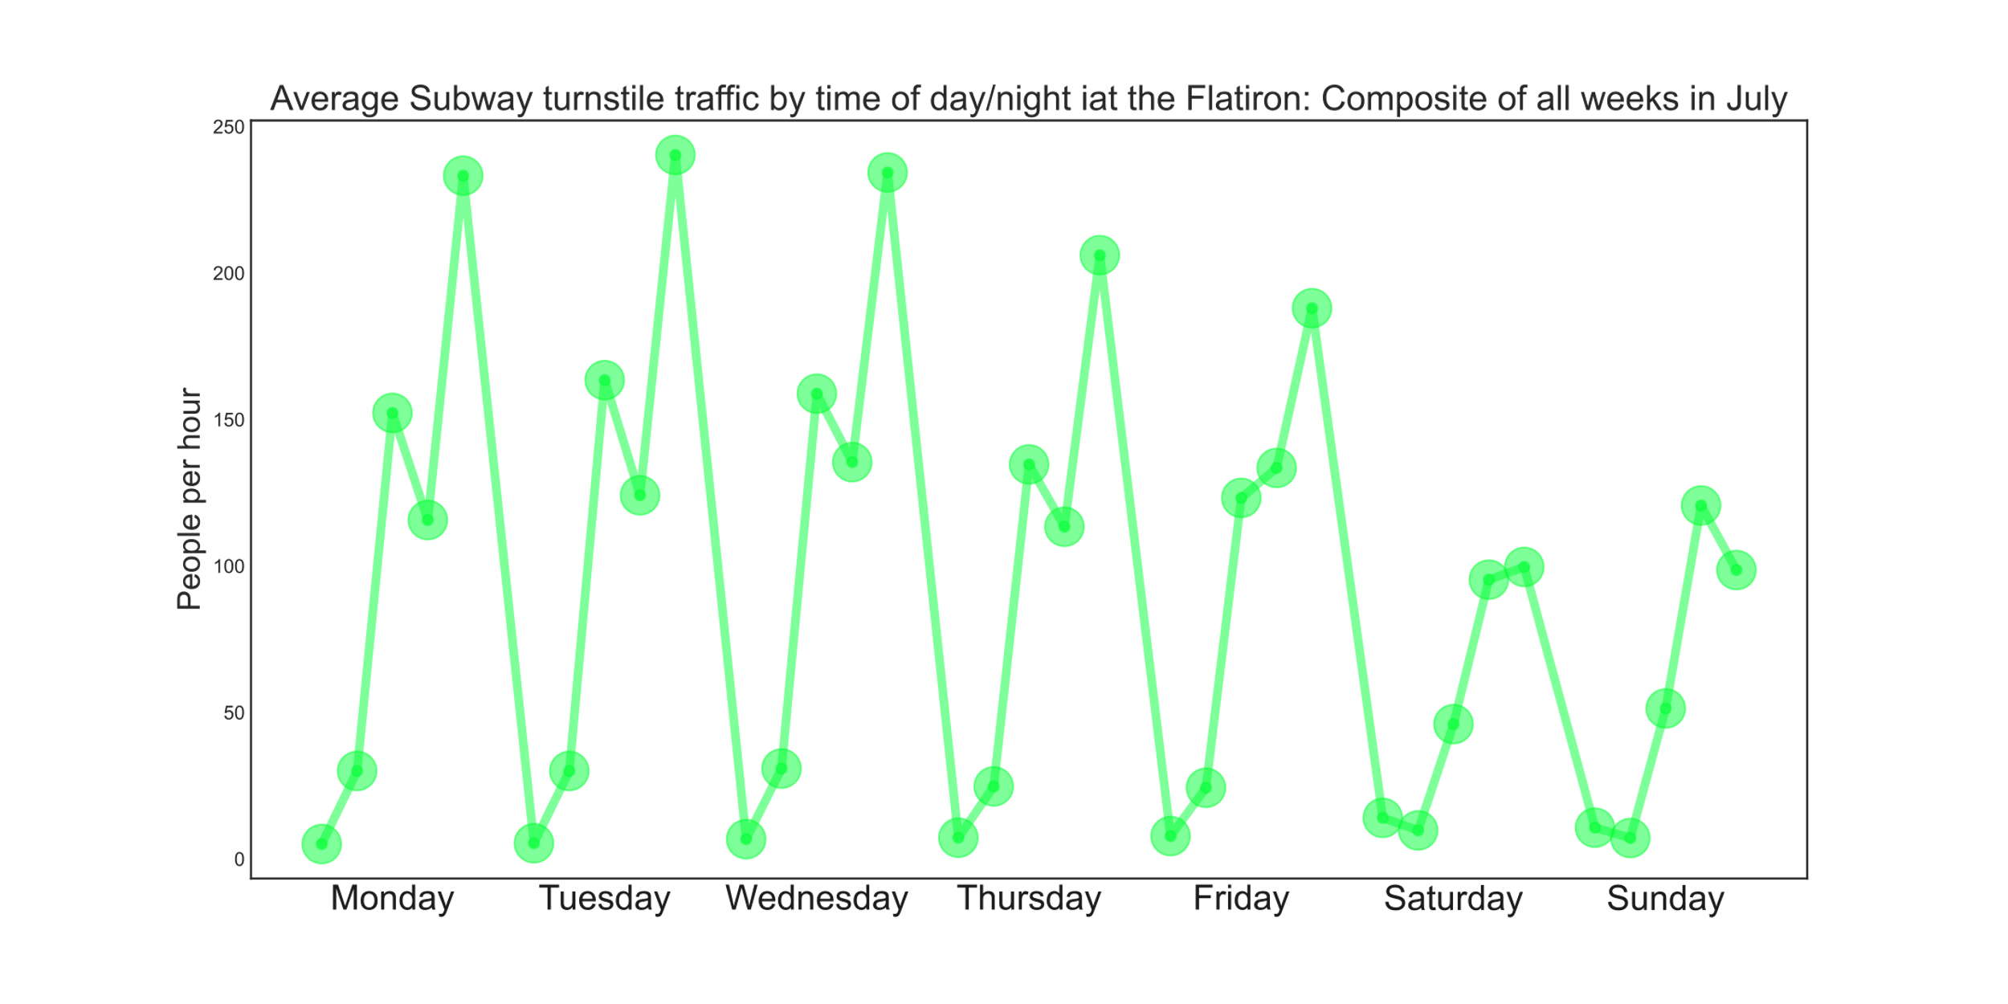
The Flatiron district: NYC’s tech hub

Slide 19
First Recommendation
The Flatiron building subway stop: 23rd and 5th Ave
Flatiron, 23rd st at Broadway and 5th Ave
8pm to midnight , Monday, Tuesday, Wednesday

Slide 20
Location, Location, Location
Pursuing a second recommendation,
by focusing on high-income neighborhoods

Slide 21
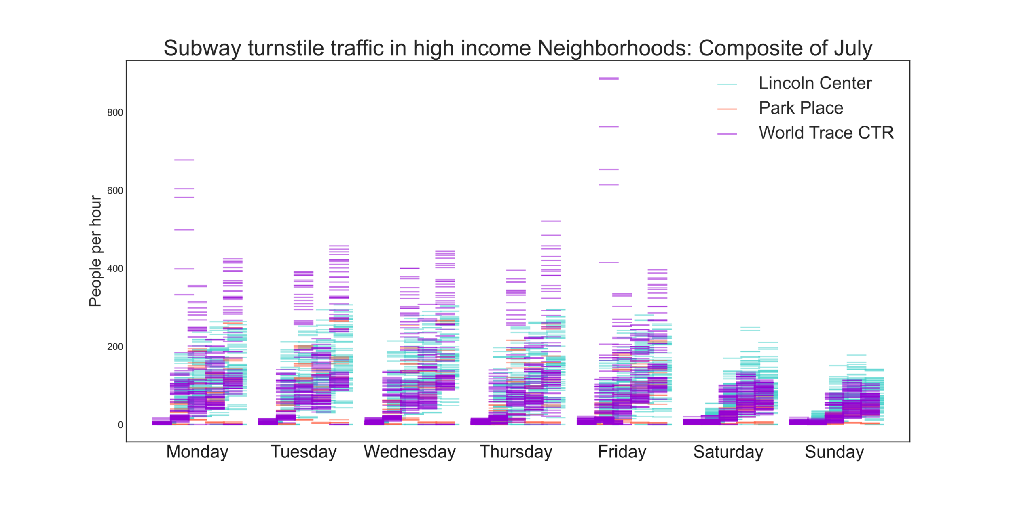
High-income neighborhoods:
• Lincoln Center
• Park Place
• World Trade CTR

Slide 22
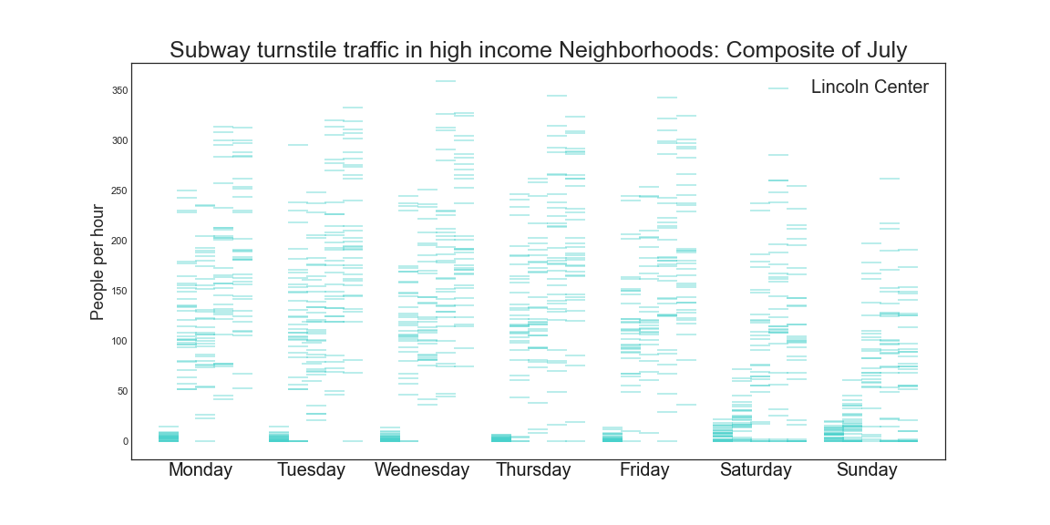
High-income neighborhoods:
• Lincoln Center
• Park Place
• World Trade CTR

Slide 23
Second Recommendation
The subway stop: 66th Street and Broadway, Lincoln Center
Lincoln Center
4pm to midnight , Monday through Thursday

Slide 24
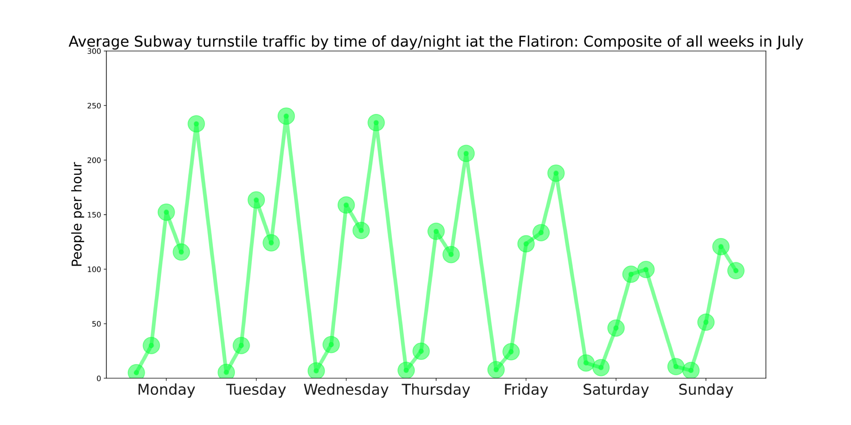
Summary
8pm to midnight ,
Monday,
Tuesday, Wednesday
Flatiron
4pm to midnight ,
Monday through Thursday
Lincoln Center

Slide 25
APPENDIX

Slide 26
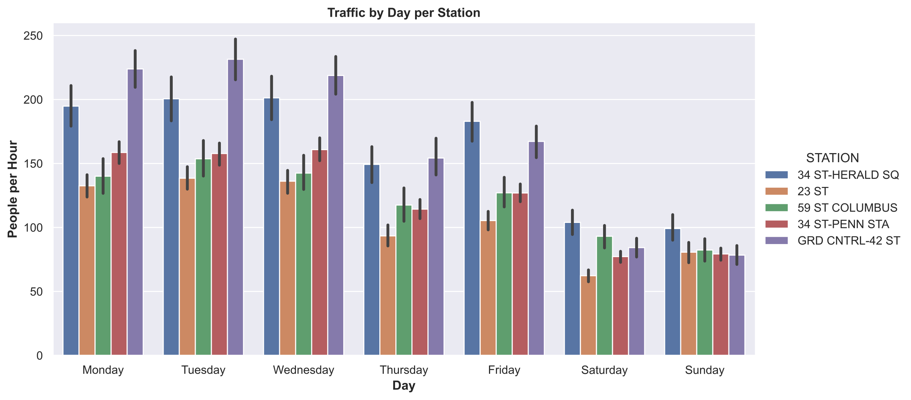

Slide 27
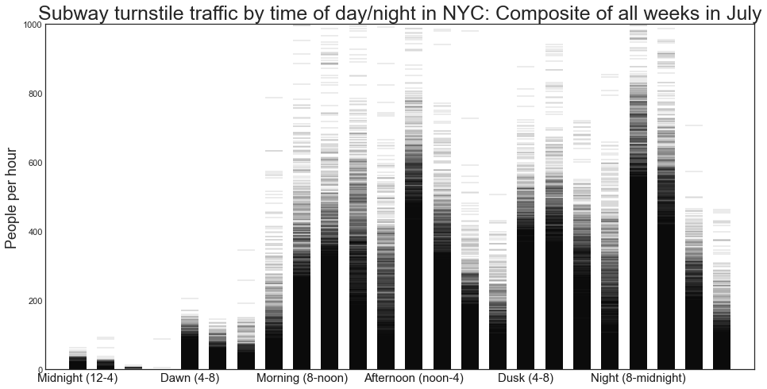
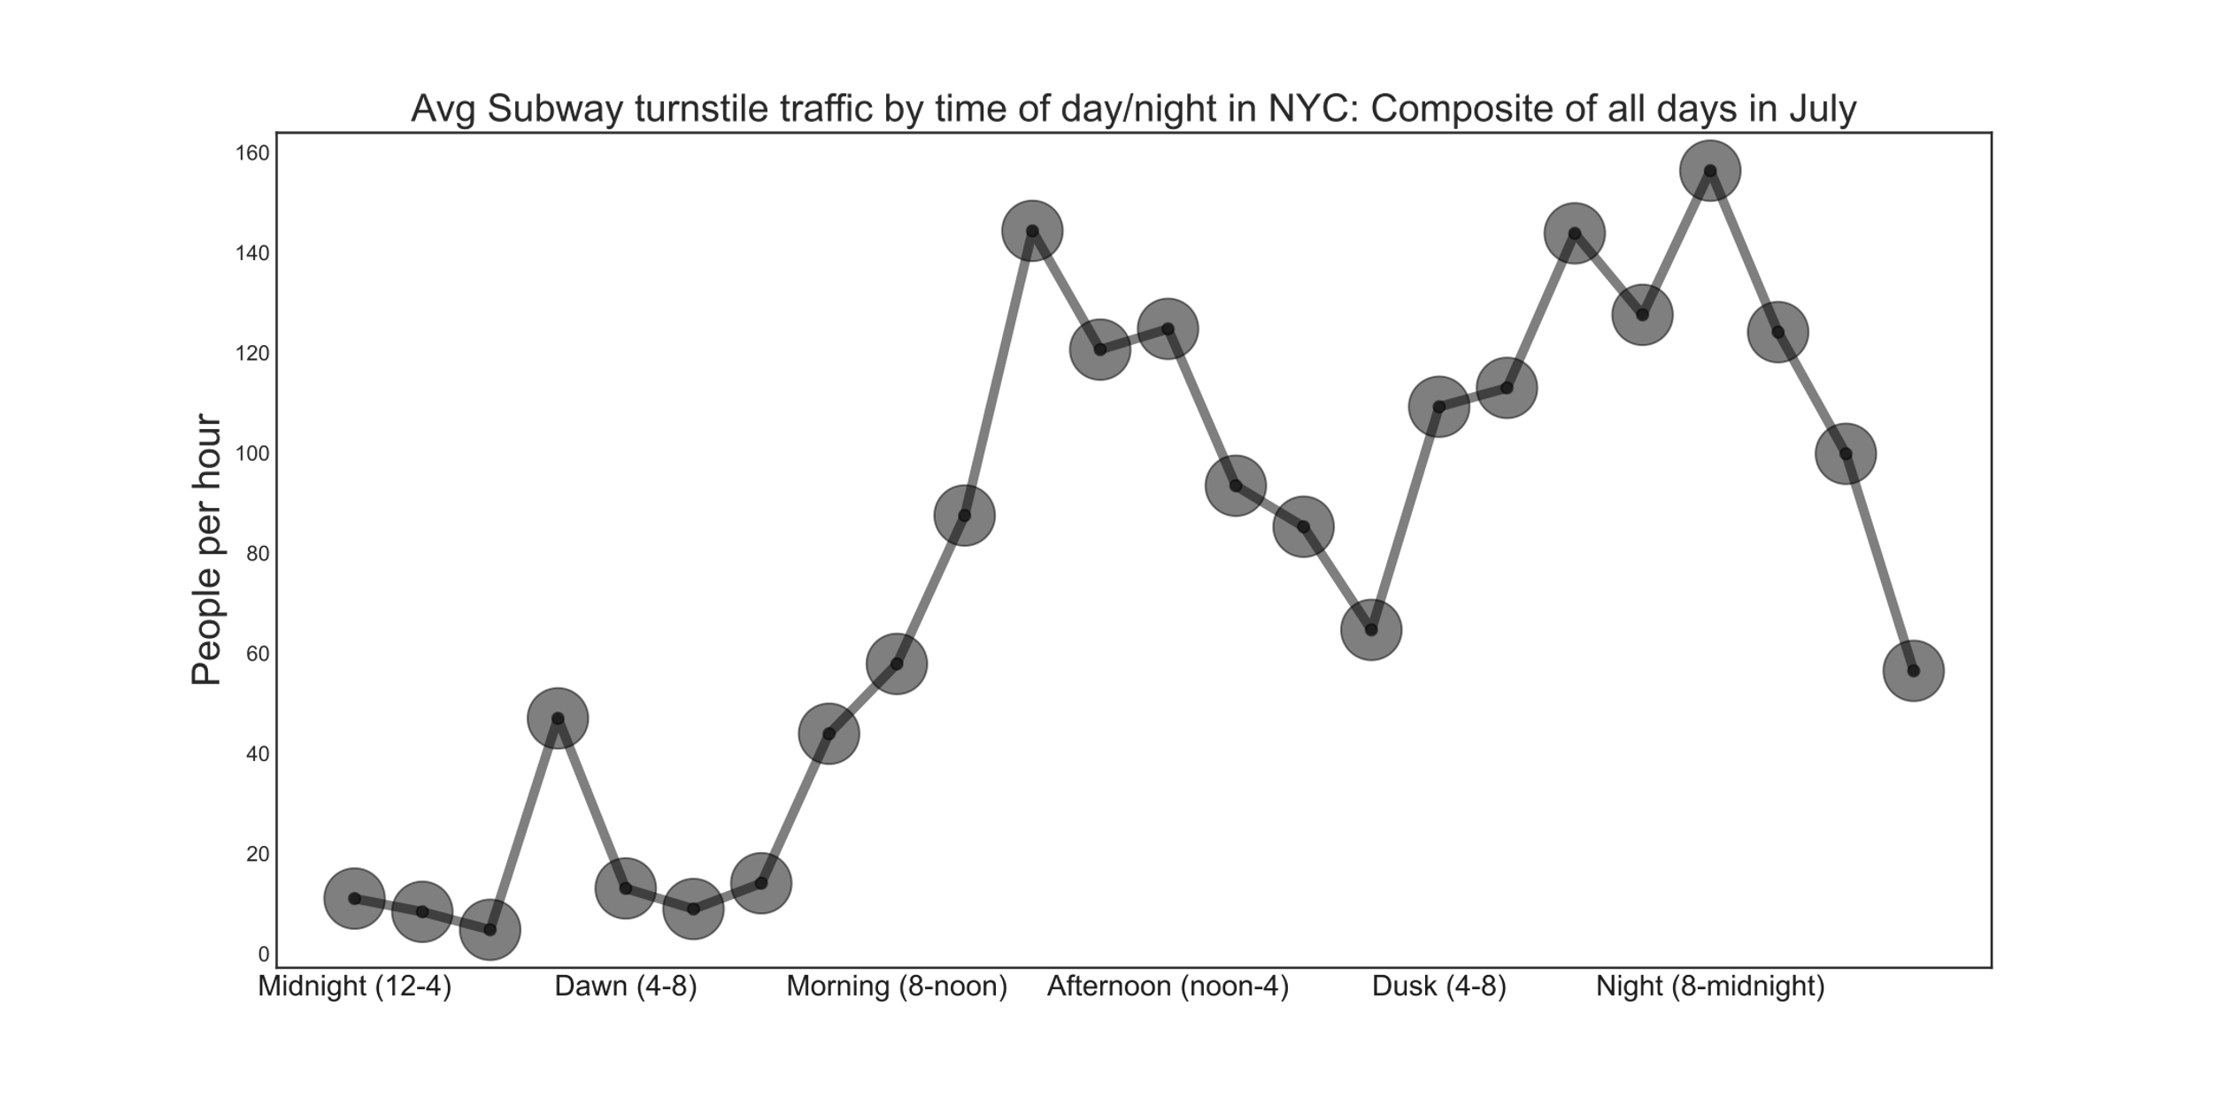
Turnstile Fluctuation By Time of Day

